Slide 1

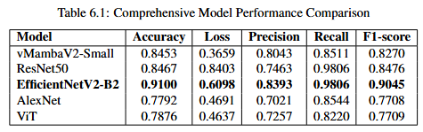
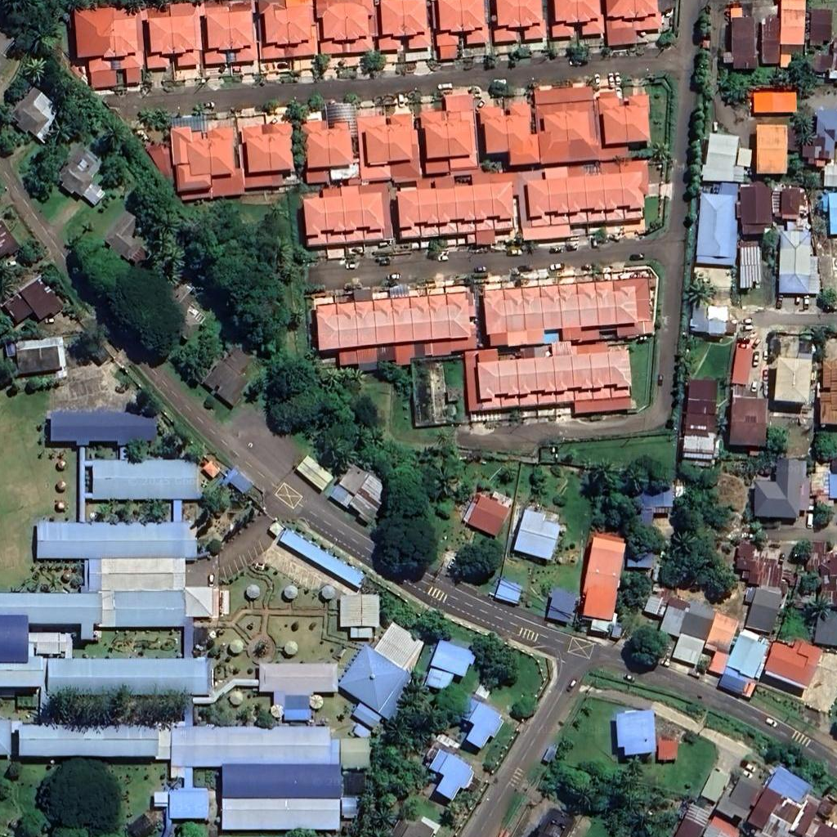
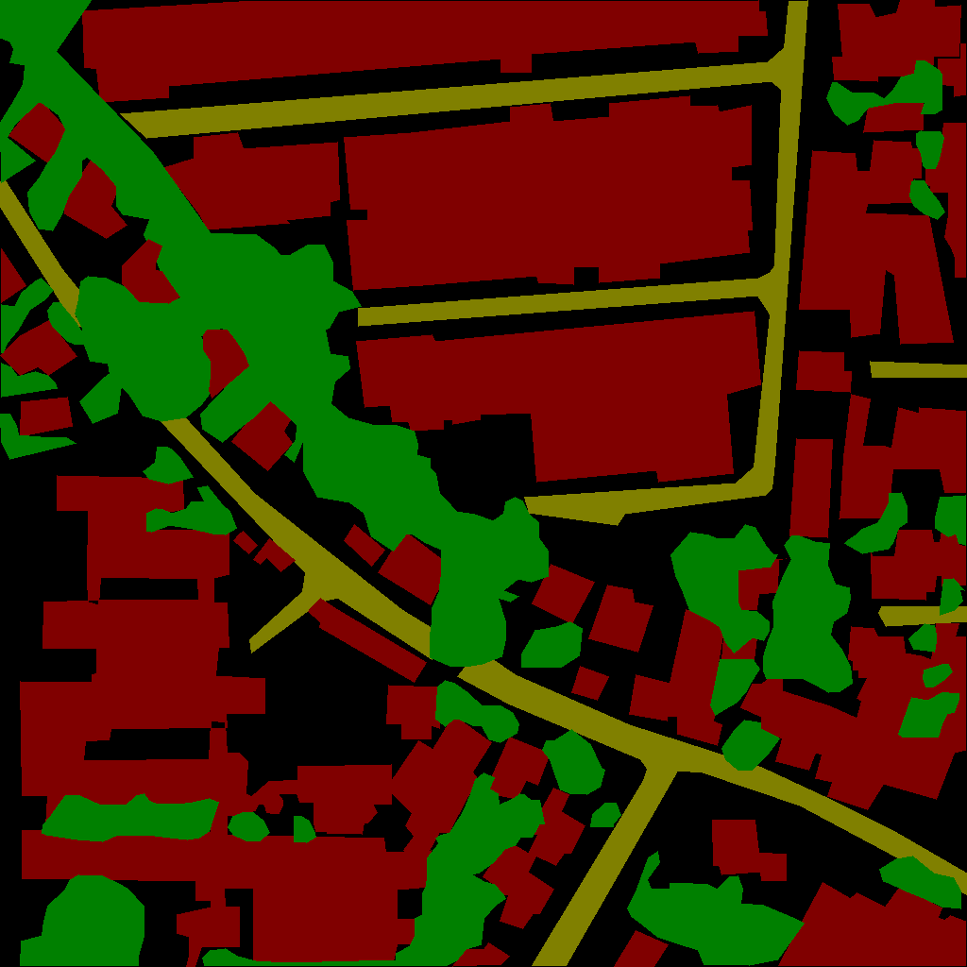
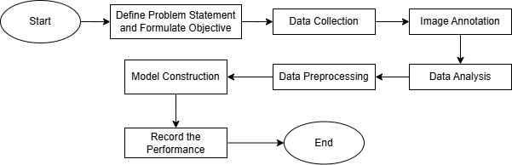
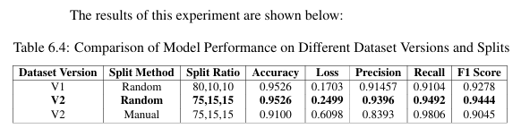
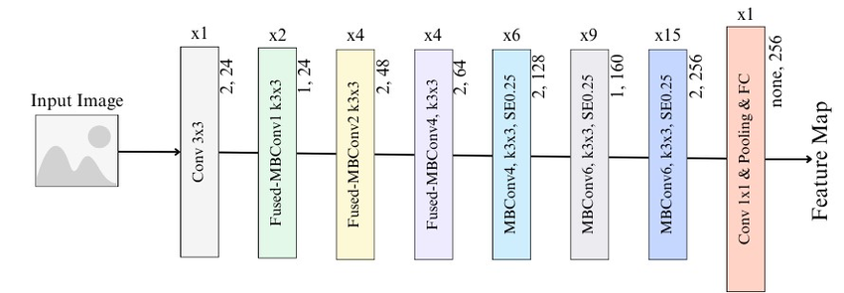
FYP02-DS-T2510-0093: LAND-COVER SEGMENTATION AND CLASSIFICATION OF SATELLITE IMAGERY
INTRODUCTION
RESEARCH METHODOLOGY
IMPLEMENTATION AND EVALUATION
Yap Jack, 1211103024
Supervisor: Dr. Pee Chih Yang,
Co-supervisor: Dr. Wong Lai Kuan,
Moderator: Dr Ng Hu
ABSTRACT
This project improves land-cover classification in Malaysia using satellite imagery, focusing on the DeepEarthMY dataset. The original dataset had an urban–rural imbalance, with too few urban images. To fix this, we added annotated urban images from Sabah and Sarawak. Analysis revealed rural areas are dominated by Agriculture and Forest, while urban areas have more Buildings and Roads. We then trained and compared deep learning models, including EfficientNet and VMamba variants, to find the best-performing architecture.
Problem Statement
VMambaV2-Small: Balanced performance with low loss, good F1-score (0.8270), and high efficiency—suitable for resource-constrained environments.
ResNet50: High recall (0.9806) but suffers from very high loss, indicating unstable predictions.
EfficientNetV2-B2: Best overall with 91.00% accuracy and 0.9045 F1-score, though slightly higher loss suggests room for calibration.
AlexNet: lowest accuracy and F1, despite decent recall.
ViT: Underperforms due to low precision, despite low loss.
Completeness and consistency of the dataset are crucial.
Accurate representation of diverse land cover types is essential.
Objective
To perform data analysis and enhance DeepEarthMY with additional annotated images.
To develop a land-cover classification model
Fig 2: Flowchart of Methodology
Literature Review
Models
CNNs: Strong performance, but high computational cost (e.g., AlexNet, ResNet).
Transformers: Better accuracy and long-range understanding, but resource-intensive (e.g., ViT, MaxViT).
Hybrid Models: uses SSM to efficiently model long sequences (e.g., Vmamba, MambaVision).
Datasets
SAT-6: U.S., 6 classes, 1m resolution, 405,000 small images (28x28) (Basu et al, 2018)
MLRSNet: Global, 60 classes, mixed resolution, 109,161 images (Qi et al, 2020)
EuroSat: Europe, 10 classes, 10m resolution, 2,700 images (Helber et al, 2019)
LoveDA: China, 7 classes, high-res (0.3m), 5,987 images (Wang et al, 2021)
DeepEarthMY (ours): Malaysia, 7 classes, 0.3m resolution, 4,007 images (Shaaban et al, 2016)
Random splits in V1 and V2 achieved better performance, with V2 random excelling in precision and F1, and V1 random in loss stability.
Manual splitting may introduce bias, reducing generalization.
Fig 2: EfficientNetV2-B2 Architecture (Aldakhil and Almutairi, 2024).
Type | Models
Mamba | VMamba
CNN | EfficientNetV2
 | EfficientNet
 | ResNet50
 | AlexNet
Transformer | Vit
CONCLUSION
Evaluation Metrics
Accuracy
Loss
Precision
F1-Score
Recall
The project achieved key milestones by enhancing the DeepEarthMY dataset, analyzing pixel and object distributions to gain insights into image characteristics and dataset balance, and implementing multiple models.
Model Performance: - EfficientNetV2-B2 outperformed all other models in accuracy, recall, precision, and F1-score.
VMamba and EfficientNet respective comparisons: - Comparison highlighted each model family's strengths, with EfficientNetV2-B2 and VMambaV2-Small having best performance in their respective families.
Dataset Version Evaluation: - Random splitting performed better than manual splitting, highlighting the critical role of appropriate dataset splitting strategies in ensuring reliability of model.

